Slide 1
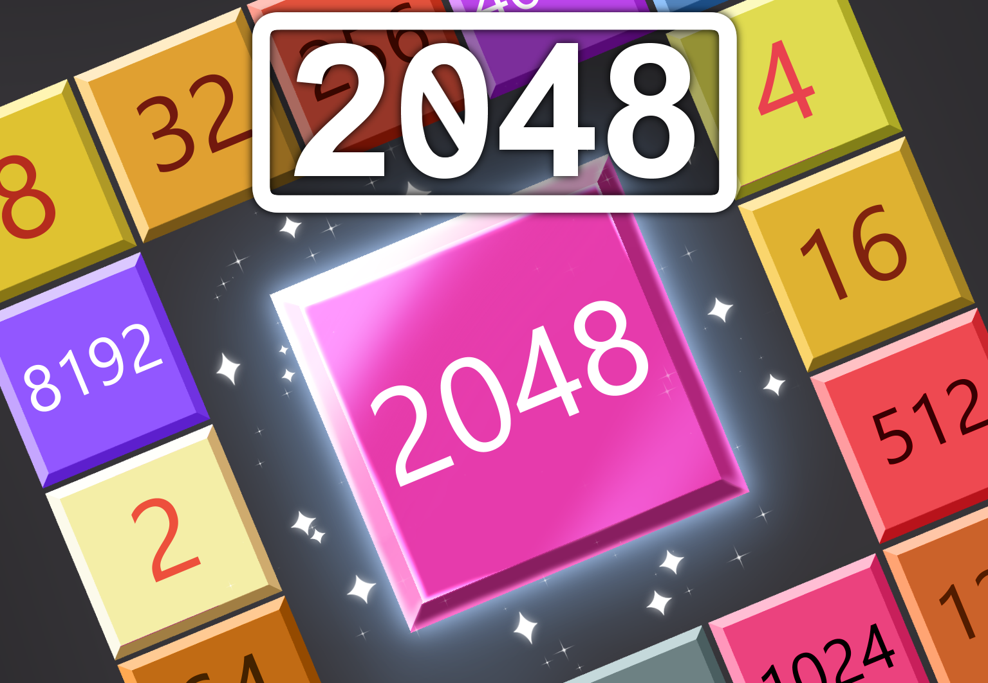


Simple but engaging!
What will be the highest number you can reach?
PAL / NTSC / OTHER
Multi-region
Cartridge
32-BIT VIRTUAL CONSOLE

